Slide 1

Volunteer Team Registration
Child Safeguarding Processes
Cameron McKern and John Roberson

Slide 2

AGENDA
Definition of contact with Children
Changes affecting all teams.
Changes affecting members of teams who will have
contact with children.
Referee questionnaire.
New processes for RAWCS Regional Volunteer Supervisors
and Regional Coordinators.

Slide 3
Will members of this team interact or engage with children in the course of volunteering?
This can include direct physical or face-to-face contact, as well as indirect forms of interaction, such as communication through digital platforms or being in a position to influence a child's environment or wellbeing.
Notes:
Definition of contact with children

Slide 4
Changes affecting all Teams

Slide 5
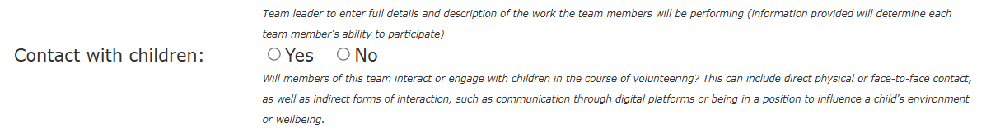
Volunteer Team Application Form

Slide 6
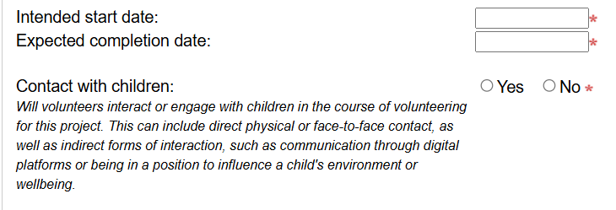
New Project Application Form

Slide 7
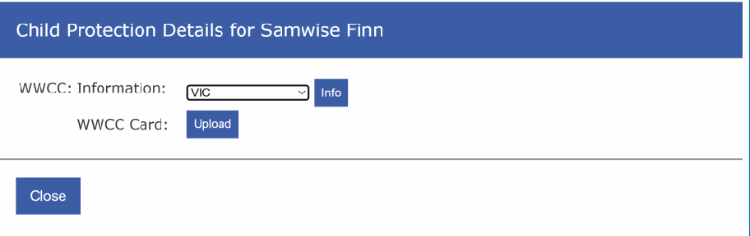

Slide 8
Changes affecting members of teams who will have contact with children

Slide 9
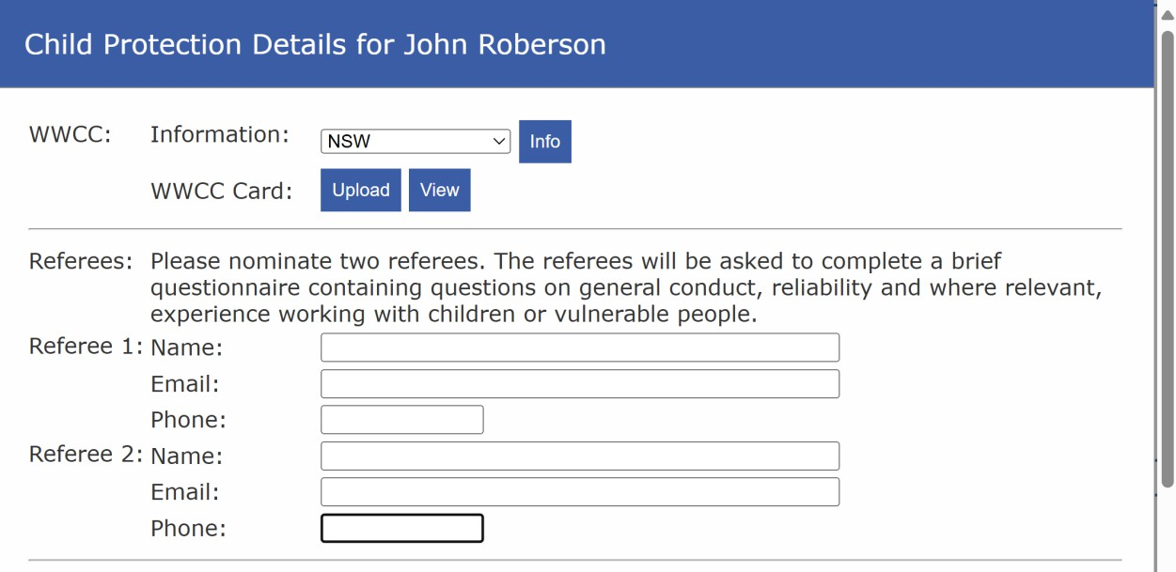

Slide 10
Each team member must supply all referee details and complete all six questions.
Each answer is not limited to the two lines displayed – the boxes will automatically expand to accommodate longer answers (up to 2,000 characters each).

Slide 11
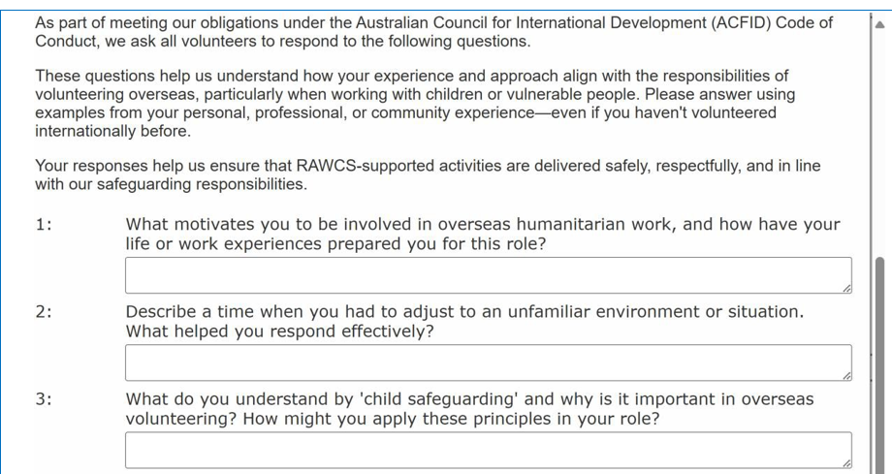
Notes:
First 3 questions

Slide 12
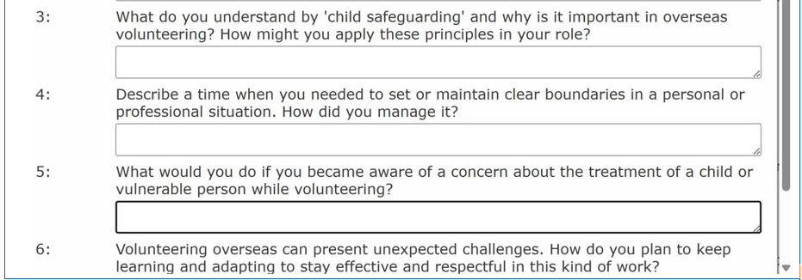
Notes:
The final 3 questions

Slide 13
Answers supplied by team members are reviewed by RAWCS supervisors and
Co-ordinators

Slide 14
Referee Questionnaire

Slide 15
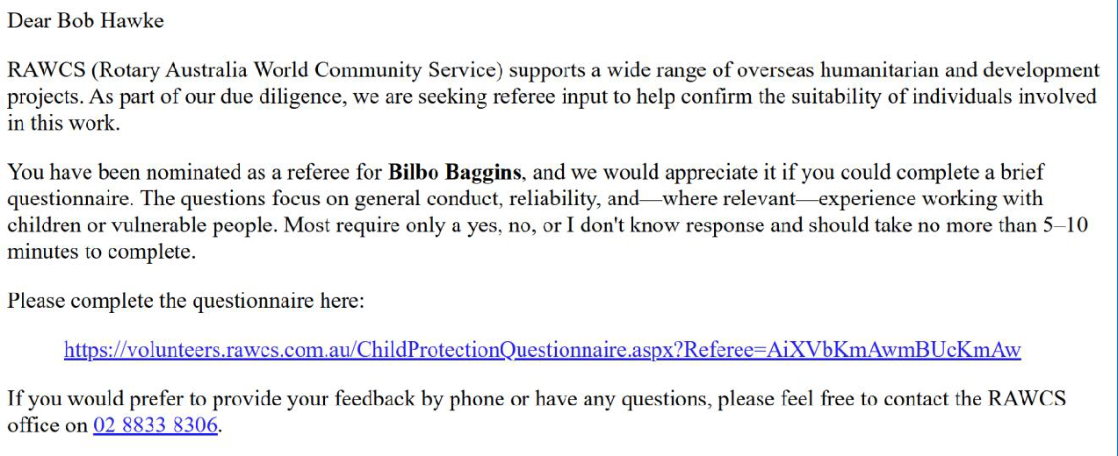
Referee Letter

Slide 16
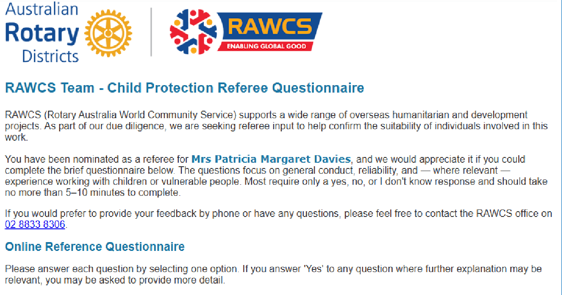
Notes:
Answer YES?NO questions

Slide 17
The thirteen questions are:
Did you work directly with the applicant in a supervisory or managerial capacity?
Was the applicant in a role that involved interaction with vulnerable individuals or children?
Was the applicant reliable and trustworthy in their role?
Notes:
Questions 1 -3

Slide 18
Did the applicant demonstrate respectful behaviour toward others, including colleagues and service users?
Were you confident in the applicant’s ability to work independently?
Are you aware of any concerns about the applicant’s behaviour toward children or young people?
(If yes, you may be asked to provide further detail)
Notes:
Questions 4-6

Slide 19
Are you aware of any incidents where the applicant breached child safety guidelines or your organisation’s code of conduct?
(If yes, you may be asked to provide further detail)
To your knowledge, has the applicant ever been the subject of a child protection investigation or disciplinary process?
(If yes, you may be asked to provide further detail)
Would you feel comfortable with the applicant working one-on-one with a child or young person?
Notes:
Questions 7-9

Slide 20
Have you ever observed the applicant respond appropriately to a concern involving a child’s safety or wellbeing?
(If yes, you may be asked to describe the situation briefly)
Would you recommend this person for a volunteer role in a humanitarian or community setting?
Would you be comfortable placing this person in a role where they may encounter vulnerable people or children?
Knowing what you know about them, would you want them on your team again?
Notes:
Questions 10-13

Slide 21
Answers supplied by the referees are reviewed by RAWCS supervisors and coordinators (see section 4, below).
Volunteer supervisors and coordinators can re-send emails to referees at any time.

Slide 22
New processes for Regional Volunteer Supervisors and Regional Coordinators

Slide 23
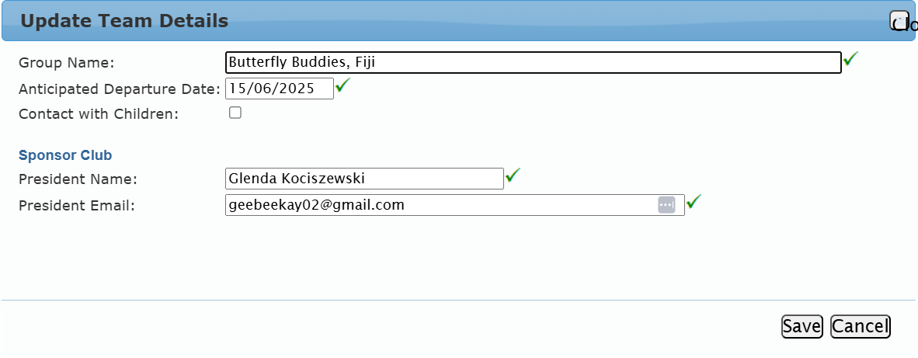
Where you can edit and check a Team is working with children
in Amend Details - EDIT

Slide 24
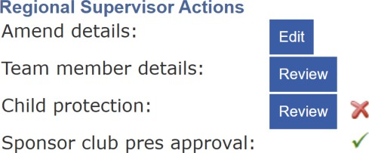

Slide 25
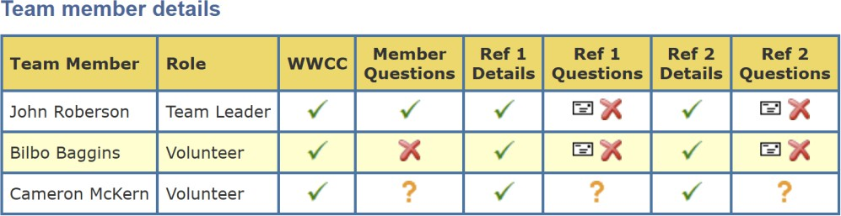

Slide 26
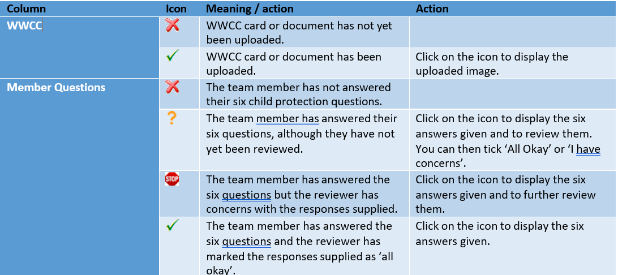

Slide 27
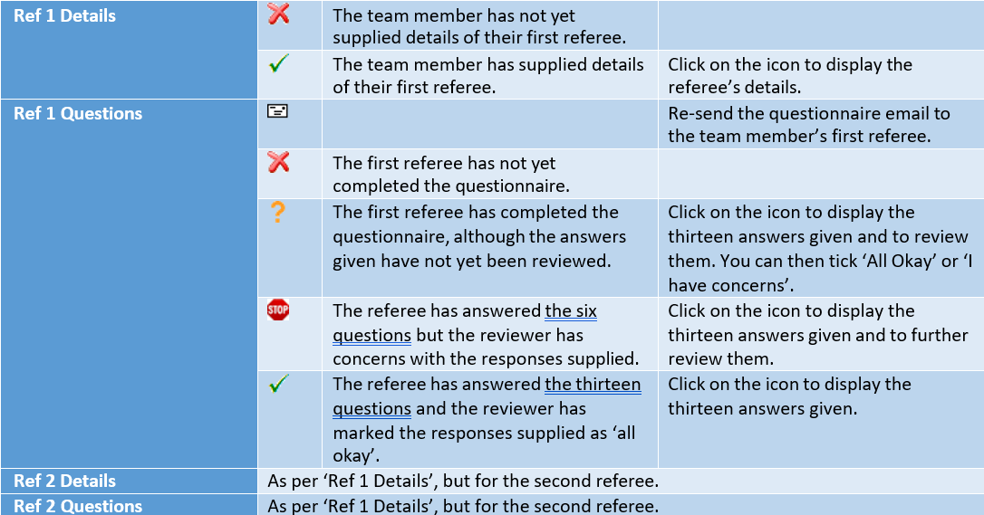

Slide 28
For a team to be successfully registered, all columns must display a green tick.

Slide 29
THANK YOU

